Slide 1
Phase 3:
We’re Building It!
bwx-bcs.org
DEBBIE ALBERT
d-albert@tti.tamu.edu
TIM LOMAX
t-lomax@tamu.edu
MADISON METSKER-GALARZA
m-metsker-galarza@tti.tamu.edu

Slide 2
What Do We Need From You?
Scheduled contract let date Dec. 2025. What if this changes?
Next steps (who/what/when/where/why/how)?
What are your questions about the design and construction schedule ideas?
What info do you need to make operational decisions? And when?
What operations are you willing to do differently? And when?
What do you have planned (or considering) in the next few years?
How do we engage your operation?

Slide 3
Are We Still Talking About This?
1999 to 2012 – Discussion, Design, Environmental approval, but no money
Feb. 2017 to Sept. 2017 – Phase 1 public engagement
48 meetings; 4,100 completed surveys with comments
Design; Construction schedule; Community effects; Mobility during construction
Sept. 2017 to present – Analysis of Solutions
Examined Phase 1 public input
Strengthened goals and vision
Design and construction schedule options
Nov. 2022 – Brazos County voters approve bond with $15 million for BWX
Feb 2023 – TTC provides additional funding for BWX; scheduled for FY 2026

Slide 4
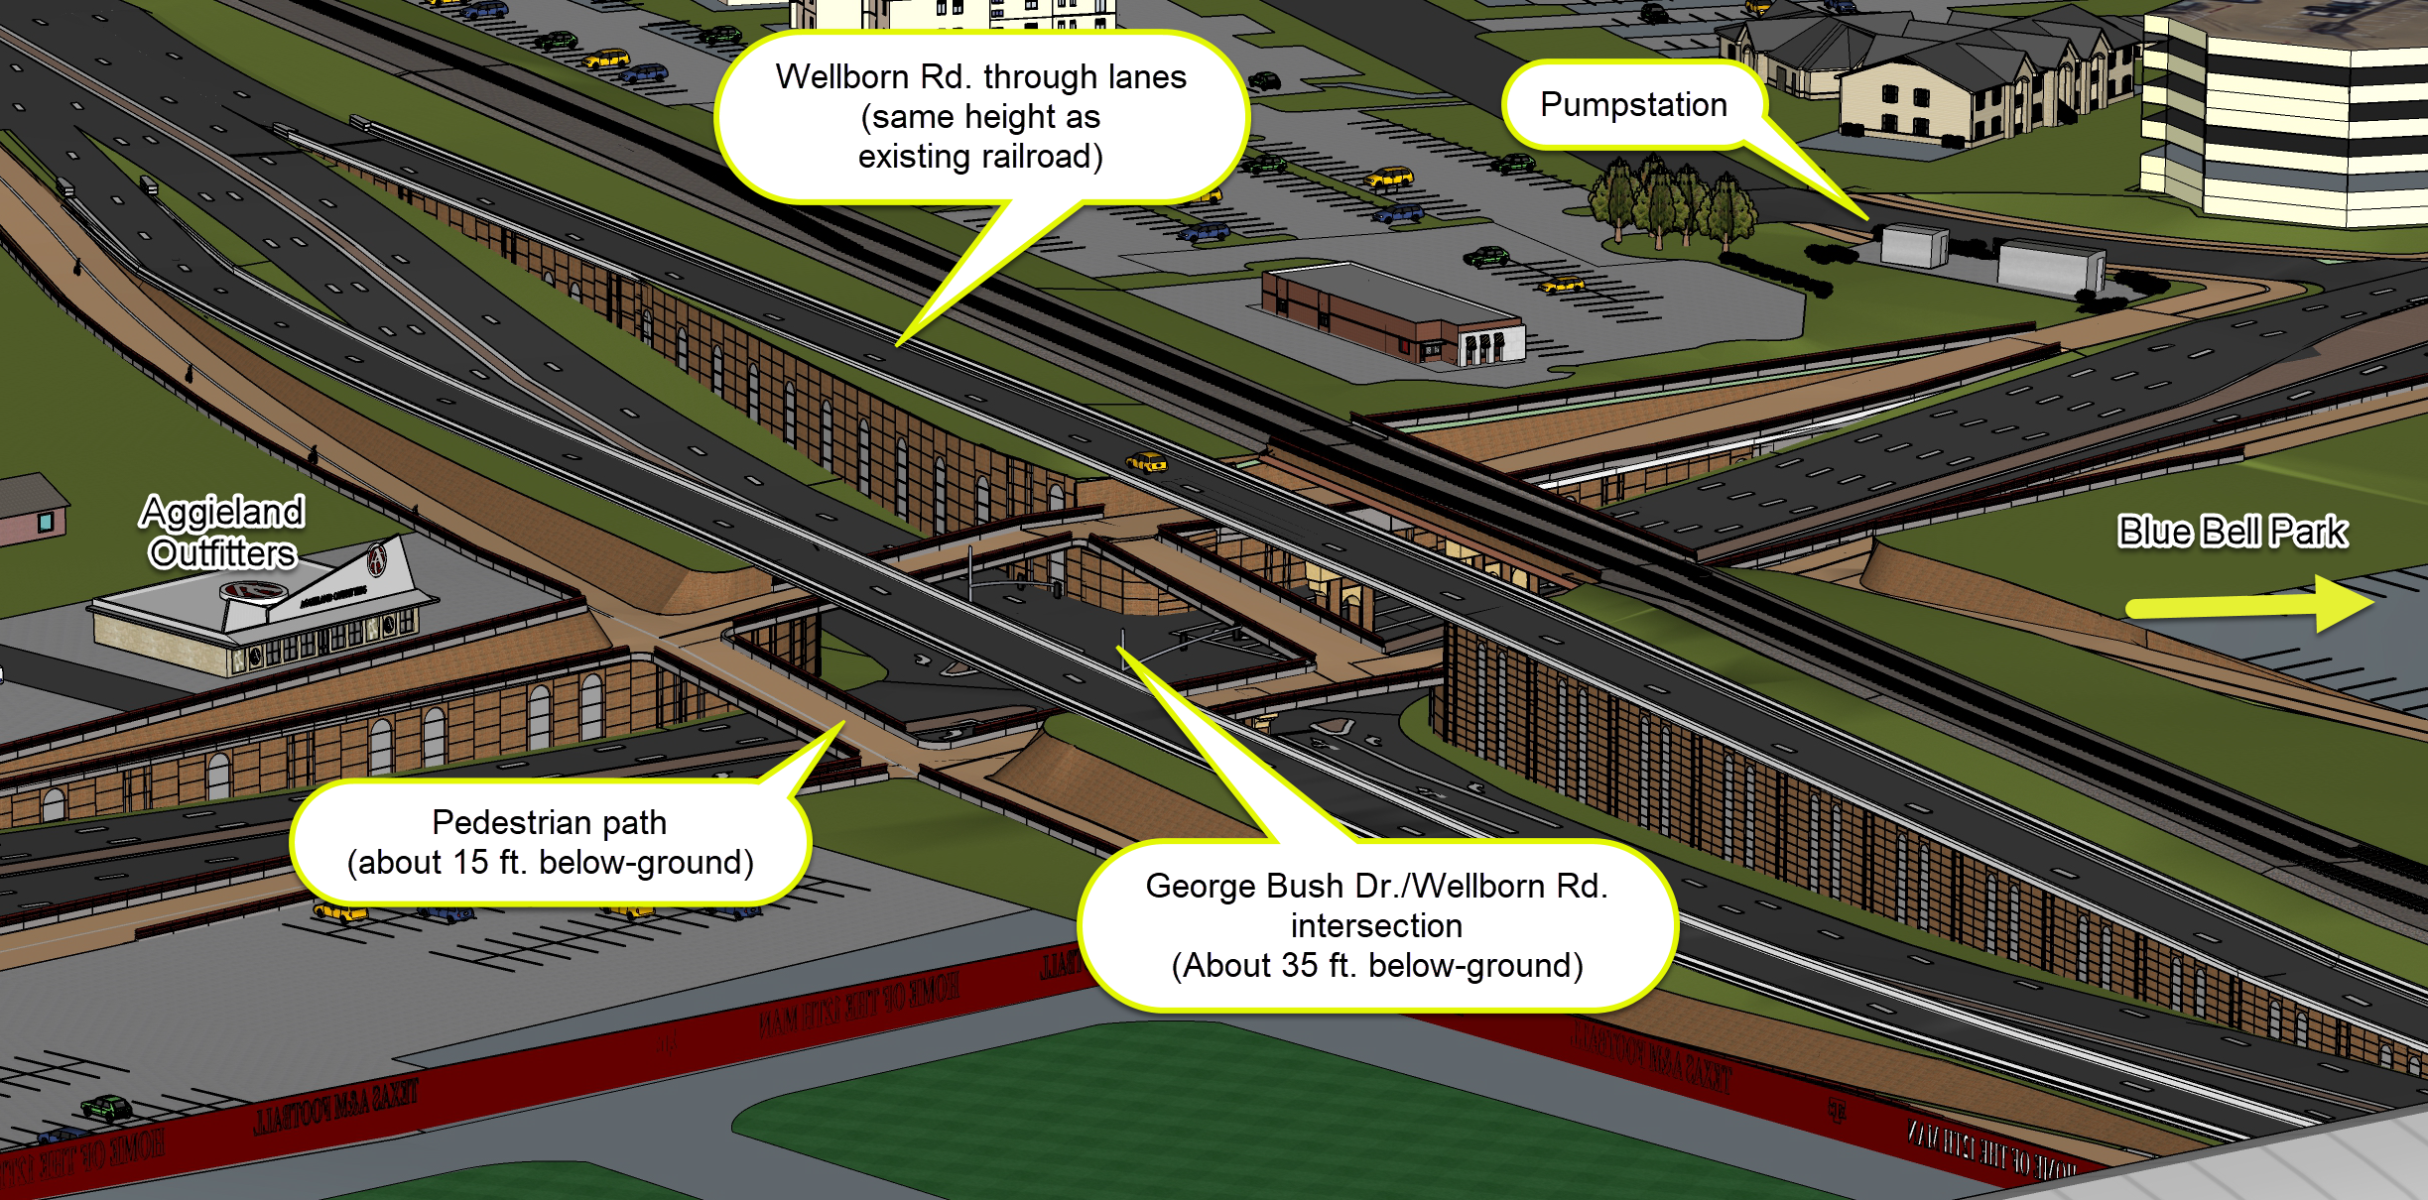
Looking southwest from Kyle Field.
DRAFT: Design not final
Below-Ground Concept for Bush-Wellborn Intersection

Slide 5
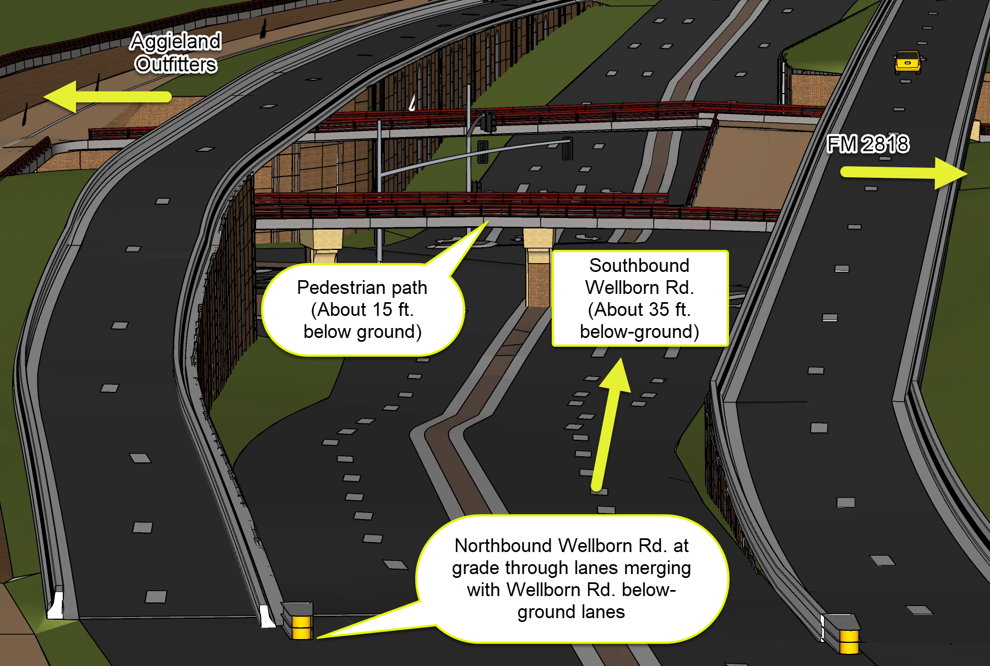
Looking south along Wellborn Road from near Kyle Field.
DRAFT: Design not final
Below-Ground Concept for Bush-Wellborn Intersection

Slide 6
How Will We Build It?
DRAFT: Design not final
These are only ideas.
Some of these may not be possible.
With any construction approach, the following will happen:
Project will be different than 2818
FM 2818 will be completed
Stay on schedule – No excuse milestones; UP Railroad coordination; Move utilities; Cost plus time bid process; Incentive payments and disincentive charges
Extensive communication throughout the project
Construction schedule ideas
Eliminate most schedule risk
Work outside traffic lanes before closure

Slide 7
When Everyone Has To Go Somewhere Else ….
What can WE do?
Maintain as much traffic capacity as possible
Adjust traffic signals and road configurations – widen Penberthy on campus
Reduce vehicle travel across the railroad
Change bus routes
Change work, class, and lab schedules and/or locations – not 8 to 5
Change parking lot designations and choices
Check travel options – try a new route or mode
Mobility coordinator - help travelers understand options
Engage the community – from now through construction

Slide 8
When Everyone Has To Go Somewhere Else ….
What can WE do?
Maintain as much traffic capacity as possible
Adjust traffic signals and road configurations – widen Penberthy on campus
Reduce vehicle travel across the railroad
Change bus routes
Change work, class, and lab schedules and/or locations – not 8 to 5
Change parking lot designations and choices
Check travel options – try a new route or mode
Mobility coordinator - help travelers understand options
Engage the community – from now through construction
Goal: No Surprises
(for anyone)

Slide 9
What Do We Need From You?
Scheduled contract let date Dec. 2025. What if this changes?
Next steps (who/what/when/where/why/how)?
What are your questions about the design and construction schedule ideas?
What info do you need to make operational decisions? And when?
What operations are you willing to do differently? And when?
Example: What’s the effect of closing Bush across the railroad track for one or more semesters on your operations?
What do you have planned (or considering) in the next few years?
How do we engage your operation?
DEBBIE ALBERT
d-albert@tti.tamu.edu
TIM LOMAX
t-lomax@tamu.edu
MADISON METSKER-GALARZA
m-metsker-galarza@tti.tamu.edu

